Slide 1
Chapter 9: Subnetting IP Networks
Introduction to Networking
Notes:
Cisco Networking Academy program
Introduction to Networking
Chapter 9: Subnetting IP Networks

Slide 2
Chapter 9
9.1 Subnetting an IPv4 Network
9.2 Addressing Schemes
9.3 Design Considerations for IPv6
9.4 Summary
Notes:
Chapter 9

Slide 3
Chapter 9: Objectives
Explain why routing is necessary for hosts on different networks to communicate.
Describe IP as a communication protocol used to identify a single device on a network.
Given a network and a subnet mask, calculate the number of host addresses available.
Calculate the necessary subnet mask in order to accommodate the requirements of a network.
Describe the benefits of variable length subnet masking (VLSM)
Explain how IPv6 address assignments are implemented in a business network.
Notes:
Chapter 9

Slide 4
Network Segmentation Reasons for Subnetting
Large networks need to be segmented into smaller sub-networks, creating smaller groups of devices and services in order to:
Control traffic by containing broadcast traffic within subnetwork
Reduce overall network traffic and improve network performance
Subnetting - process of segmenting a network into multiple smaller network spaces called subnetworks or Subnets.
Communication Between Subnets
A router is necessary for devices on different networks and subnets to communicate.
Each router interface must have an IPv4 host address that belongs to the network or subnet that the router interface is connected to.
Devices on a network and subnet use the router interface attached to their LAN as their default gateway.
Notes:
9.1 Subnetting an IPv4 Network
9.1.1 Network Segmentation
9.1.1.1 Reasons for Subnetting
9.1.1.2 Communication Between Subnets

Slide 5
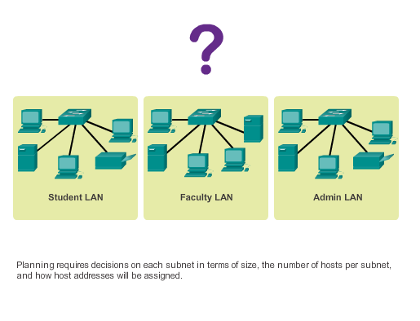
Subnetting an IPv4 Network IP Subnetting is FUNdamental
Notes:
9.1.2 IP Subnetting is FUNdamental
9.1.2.1 The Plan
9.1.2.2 The Plan - Address Assignment

Slide 6
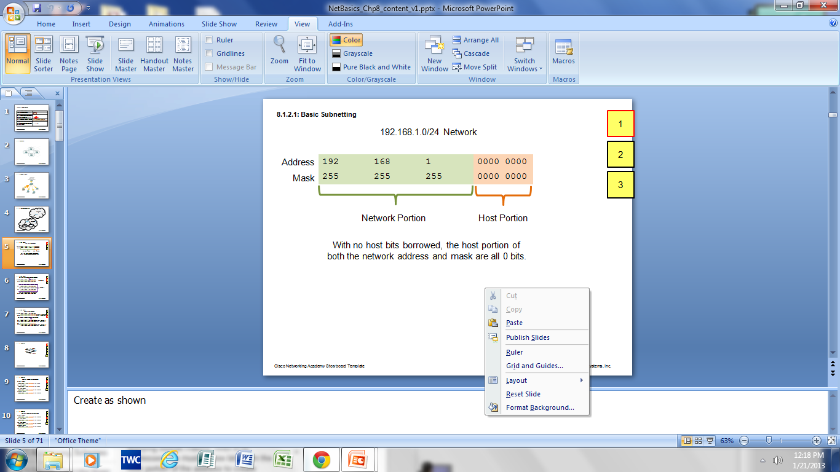
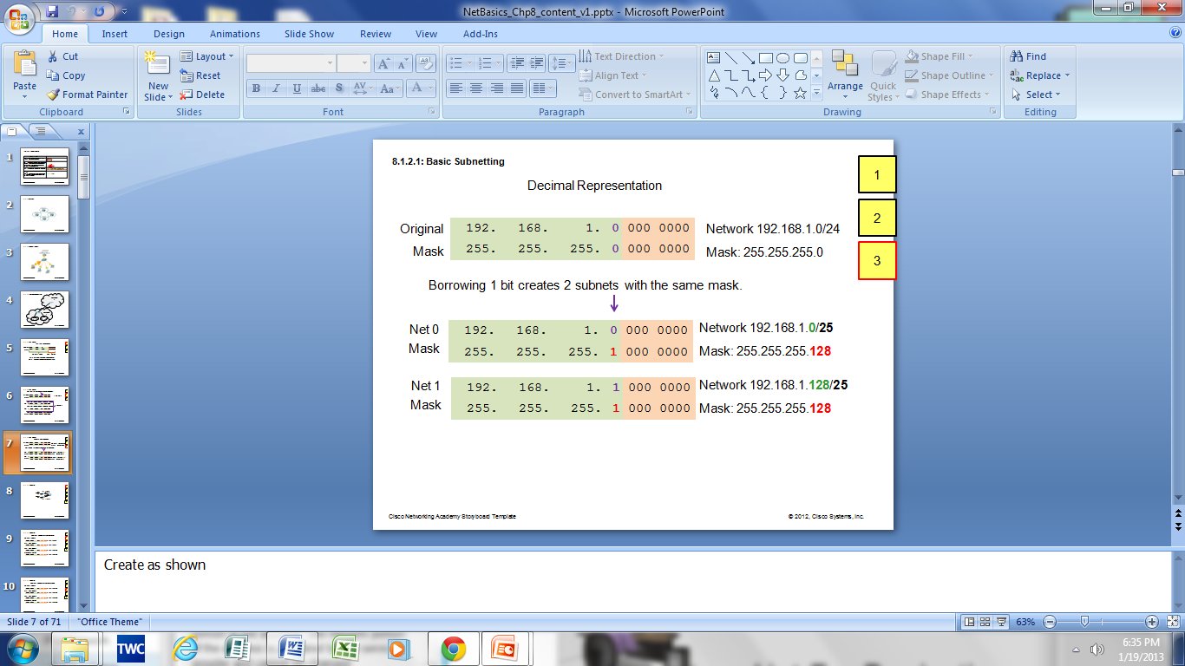
Subnetting an IPv4 Network Basic Subnetting
Borrowing Bits to Create Subnets
Borrowing 1 bit 2¹ = 2 subnets
Borrowing 1 Bit from the host portion creates 2 subnets with the same subnet mask
Subnet 0
Network 192.168.1.0-127/25
Mask: 255.255.255.128
Subnet 1
Network 192.168.1.128-255/25
Mask: 255.255.255.128
Notes:
9.1.3 Subnetting an IPv4 Network
9.1.3.1 Basic Subnetting

Slide 7
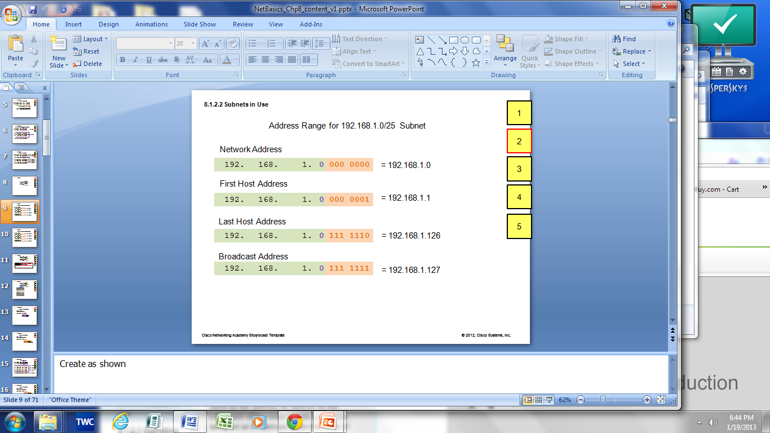
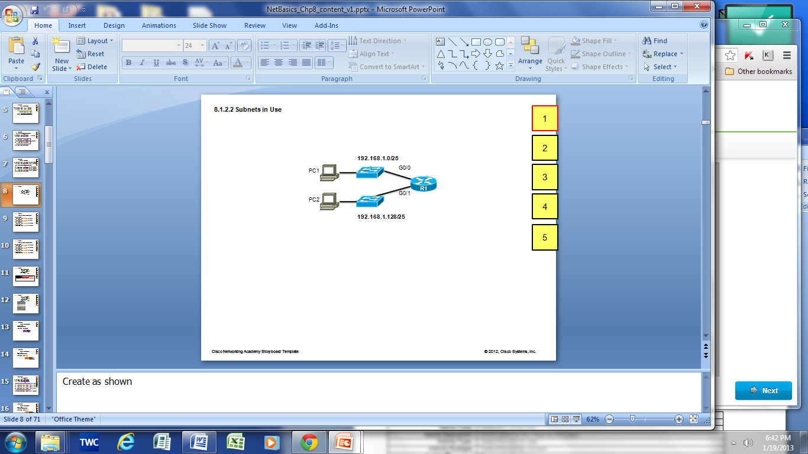

Subnetting an IPv4 Network Subnets in Use
Subnet 0
Network 192.168.1.0-127/25
Subnet 1
Network 192.168.1.128-255/25
Notes:
9.1.3.2 Subnets in Use

Slide 8
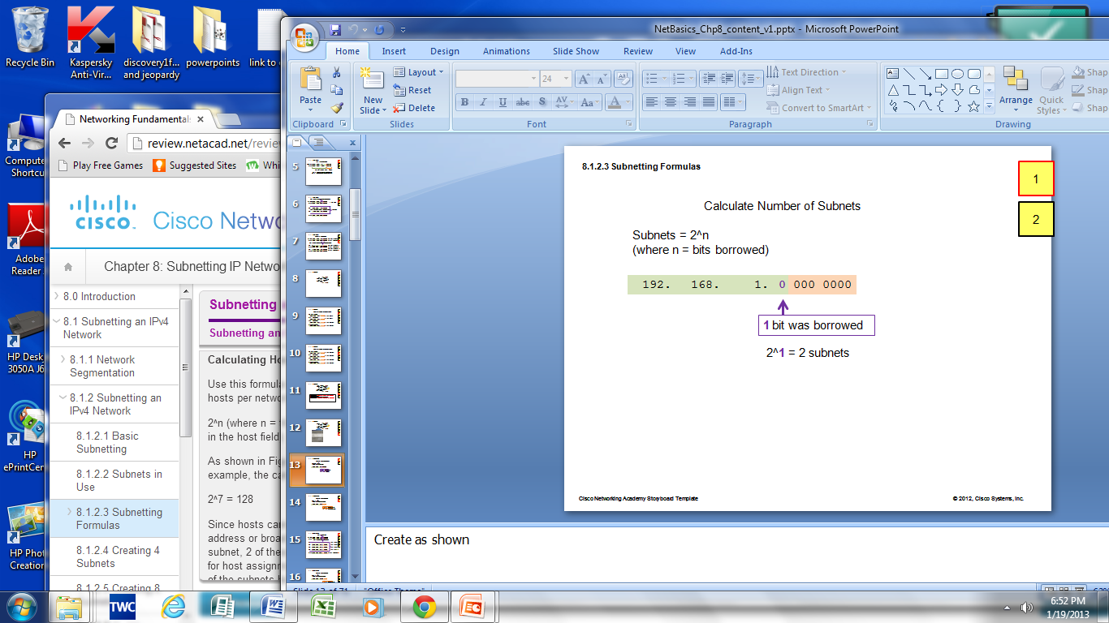
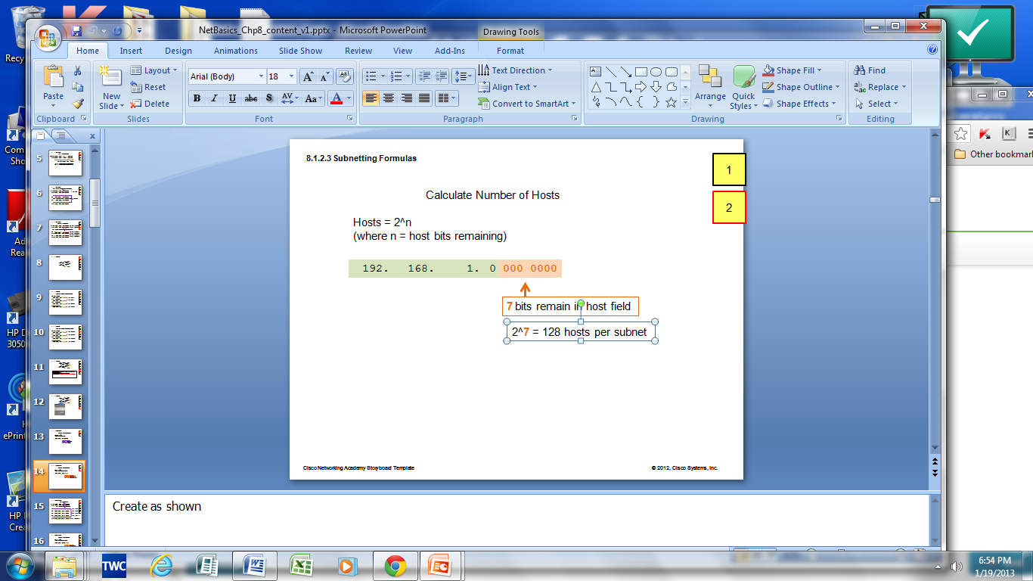
Subnetting an IPv4 Network Subnetting Formulas
Calculate Number of Subnets
Calculate Number of Hosts
Notes:
9.1.3.3 Subnetting Formulas

Slide 9
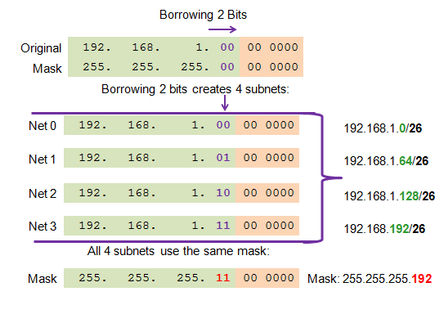
Subnetting an IPv4 Network Creating 4 Subnets
Borrowing 2 bits to create 4 subnets. 2² = 4 subnets
Notes:
9.1.3.4 Creating 4 subnets

Slide 10
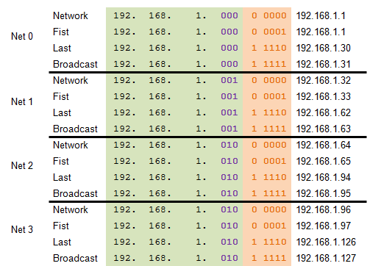
Subnetting an IPv4 Network Creating 8 Subnets
Borrowing 3 bits to Create 8 Subnets. 2³ = 8 subnets
Notes:
9.1.3.5 Creating 8 subnets

Slide 11
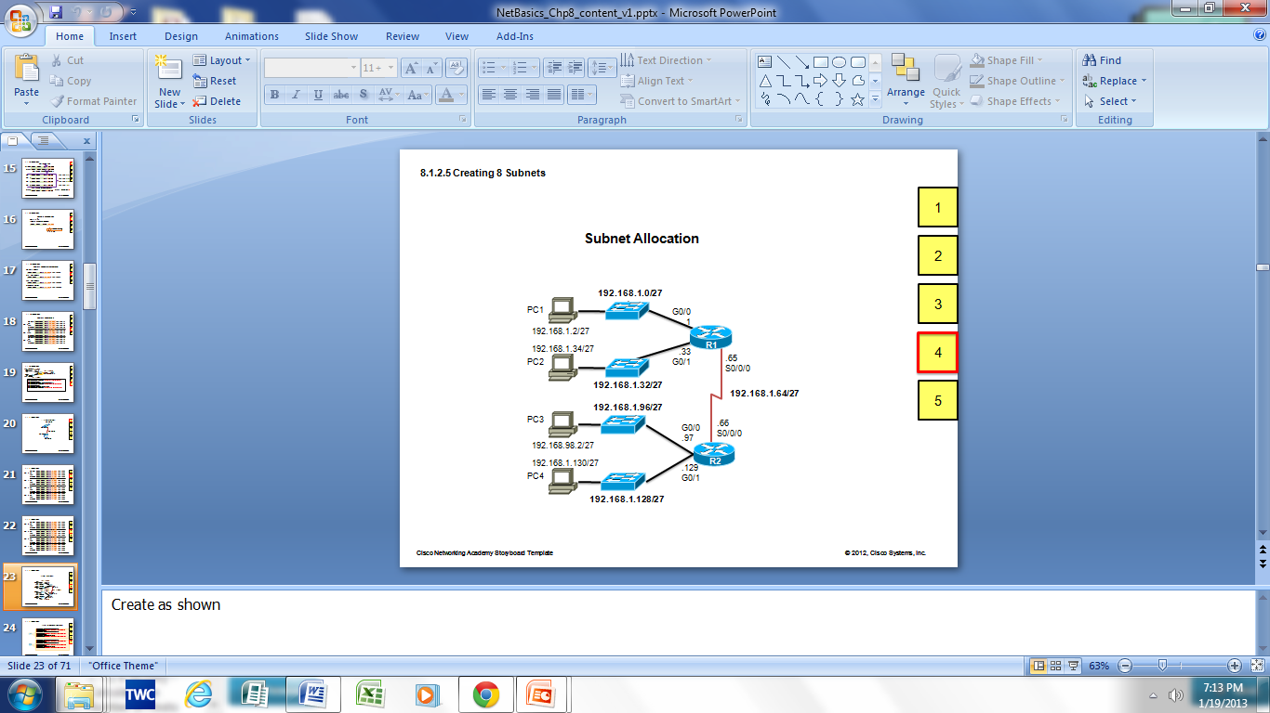
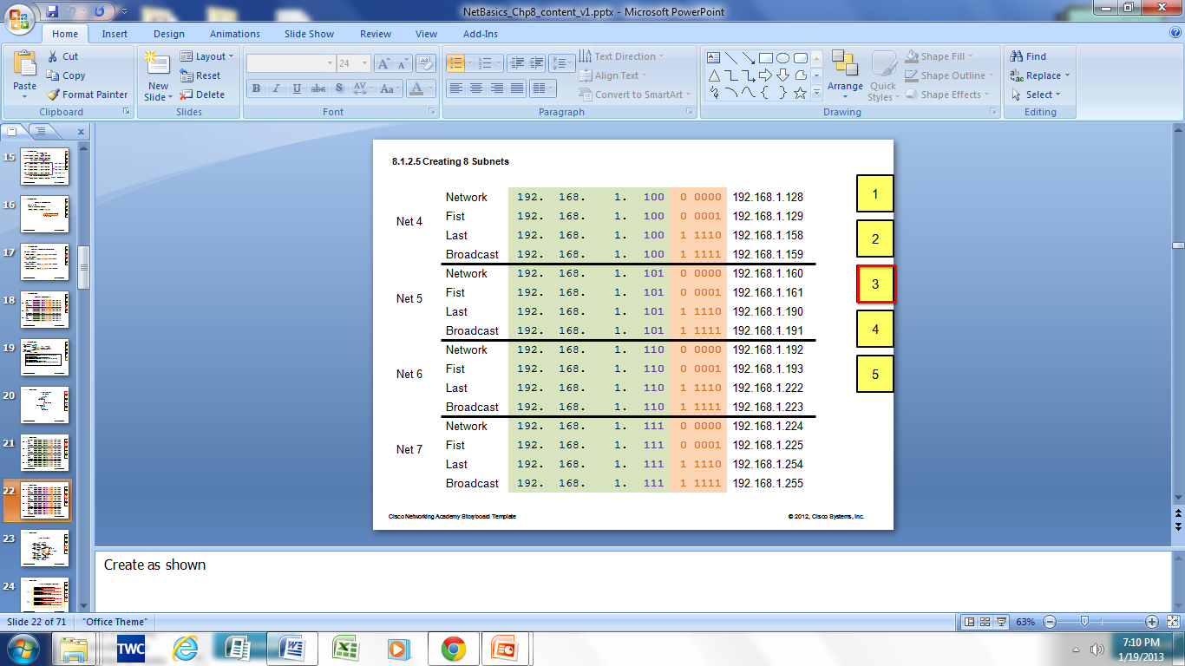
Subnetting an IPv4 Network Creating 8 Subnets(continued)
Notes:
9.1.3.5 Creating 8 Subnets (continued)

Slide 12
Determining the Subnet Mask Subnetting Based on Host Requirements
There are two considerations when planning subnets:
Number of Subnets required
Number of Host addresses required
Formula to determine number of useable hosts
2^n-2
2^n (where n is the number the number of host bits remaining) is used to calculate the number of hosts
-2 Subnetwork ID and broadcast address cannot be used on each subnet
Notes:
9.1.4 Determining the Subnet Mask
9.1.4.1 Subnetting based on Host Requirements

Slide 13
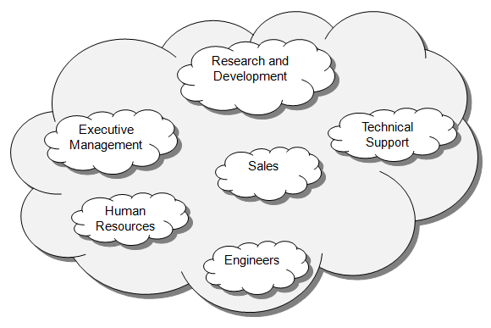
Determining the Subnet Mask Subnetting Network-Based Requirements
Calculate number of subnets
Formula 2^n (where n is the number of bits borrowed)
Subnet needed for each department in graphic
Notes:
9.1.4.2 Subnetting Network-Based Requirements

Slide 14
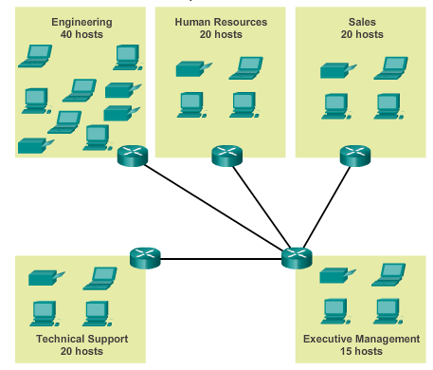
Determining the Subnet Mask Subnetting To Meet Network Requirements
It is important to balance the number of subnets needed and the number of hosts required for the largest subnet.
Design the addressing scheme to accommodate the maximum number of hosts for each subnet.
Allow for growth in
each subnet.
Notes:
9.1.4.3 Subnetting to Meet Network Requirements

Slide 15
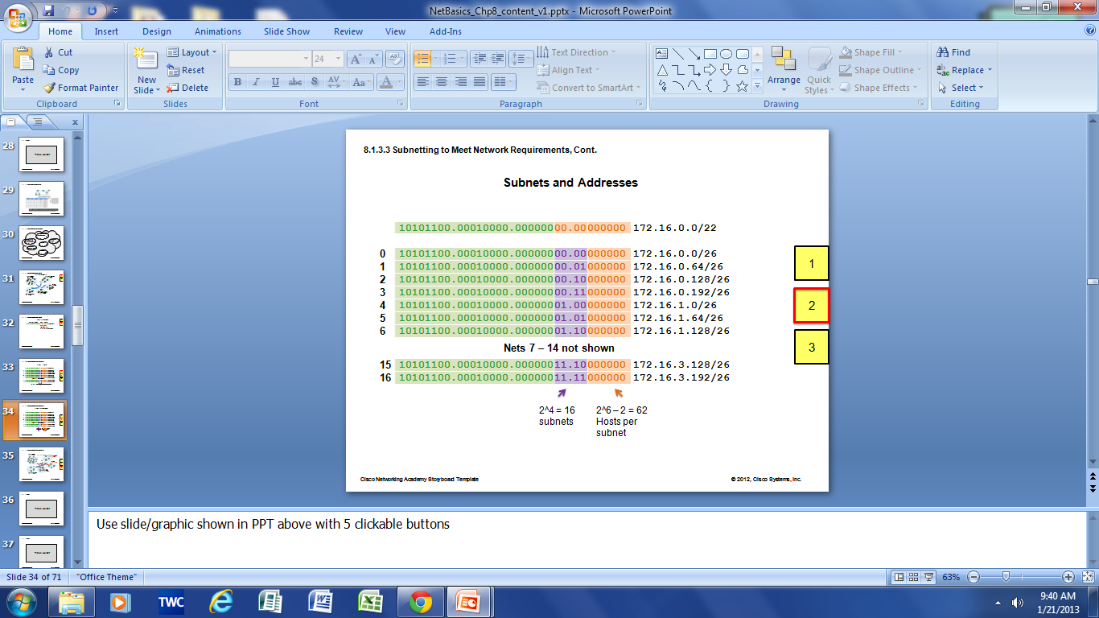
Determining the Subnet Mask Subnetting To Meet Network Requirements (cont)
Notes:
9.1.4.4 Subnetting to Meet Network Requirements (Cont)

Slide 16
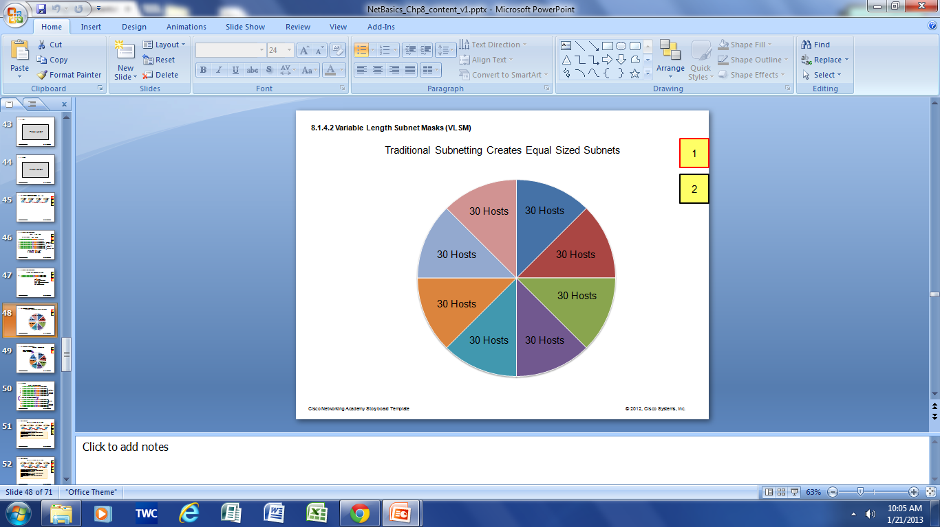
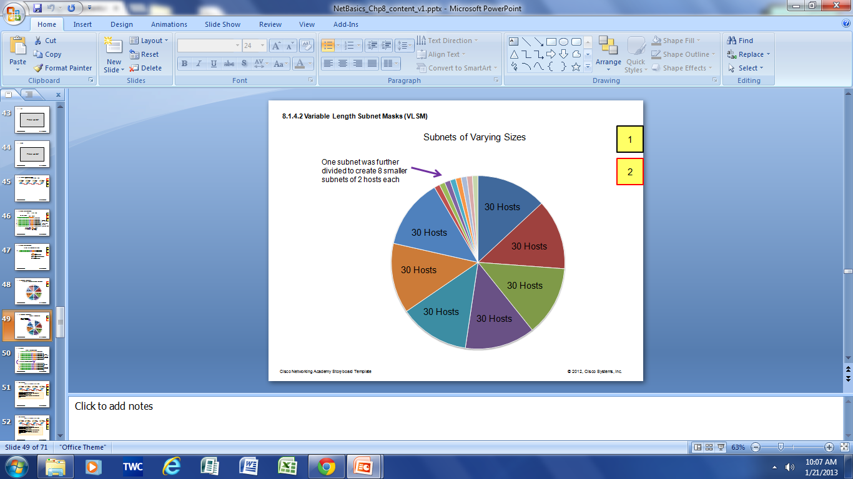
Benefits of Variable Length Subnet Masking Traditional Subnetting Wastes Addresses
Traditional subnetting - same number of addresses is allocated for each subnet.
Subnets that require fewer addresses have unused (wasted) addresses. For example, WAN links only need 2 addresses.
Variable Length Subnet Mask (VLSM) or subnetting a subnet provides more efficient use of addresses.
Notes:
9.1.5 Benefits of Variable Length Subnet Masking
9.1.5.1 Traditional Subnetting Wastes Addresses
9.1.5.2 Variable Length Subnet Mask (VLSM)

Slide 17
Benefits of Variable Length Subnet Masking Variable Length Subnet Masks (VLSM)
VLSM allows a network space to be divided in unequal parts.
Subnet mask will vary depending on how many bits have been borrowed for a particular subnet.
Network is first subnetted, and then the subnets are subnetted again.
Process repeated as necessary to create subnets of various sizes.
Notes:
9.1.4.2 Variable Length Subnet Masks (VLSM)

Slide 18
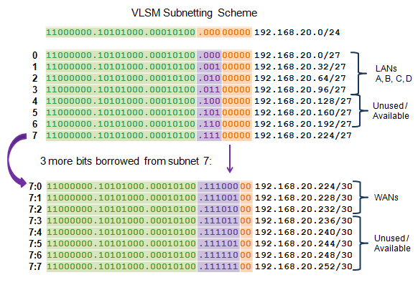
Benefits of Variable Length Subnet Masking Basic VLSM
Notes:
9.1.5.3 Basic VLSM

Slide 19
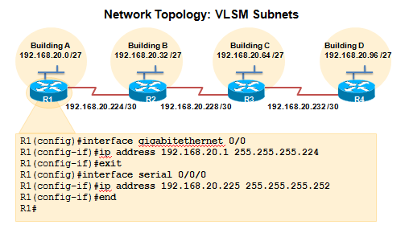
Benefits of Variable Length Subnet Masking VLSM in Practice
Using VLSM subnets, the LAN and WAN segments in example below can be addressed with minimum waste.
Each LANs will be assigned a subnet with /27 mask.
Each WAN link will be assigned a subnet with /30 mask.
Notes:
9.1.5.4 VLSM in Practice

Slide 20
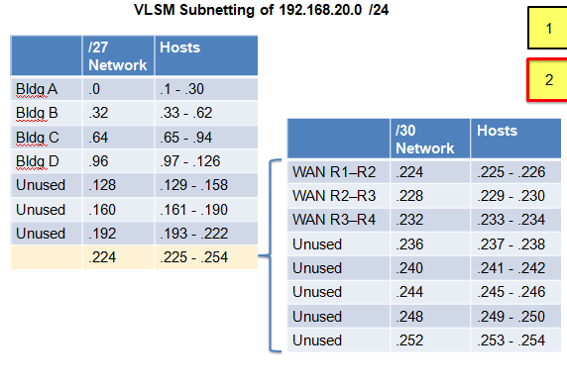
Benefits of Variable Length Subnet Masking VLSM Chart
Notes:
9.1.5.5 VLSM Chart

Slide 21
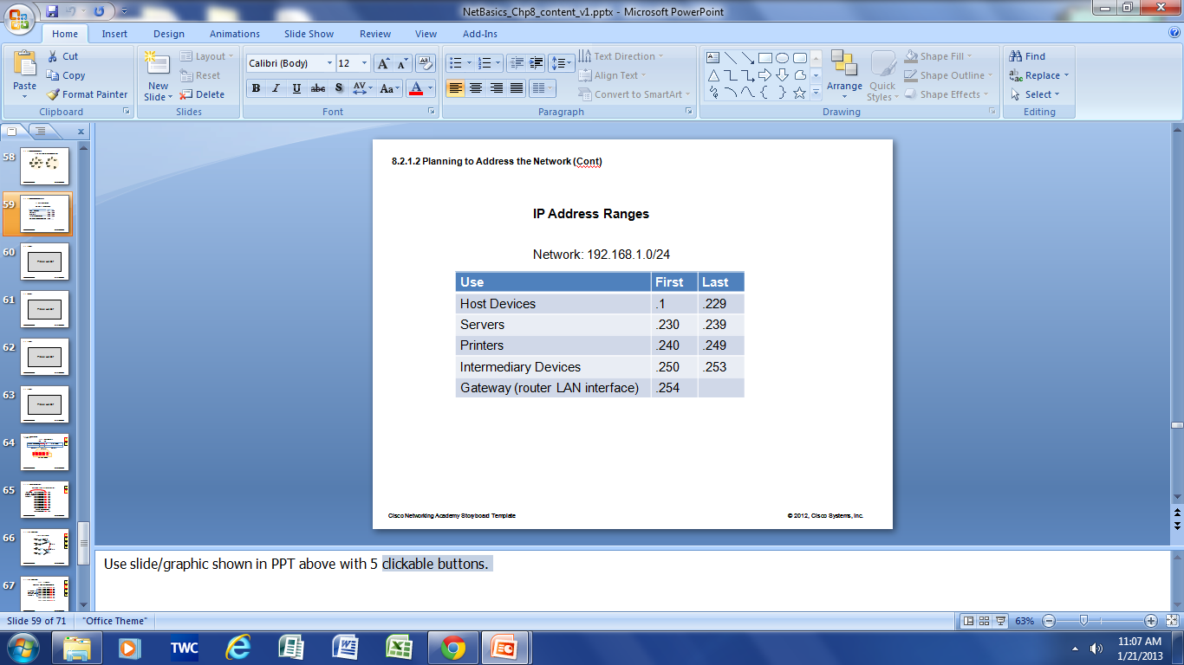
Structured Design Planning to Address the Network
Allocation of network addresses should be planned and documented for the purposes of:
Preventing duplication of addresses
Providing and controlling access
Monitoring security and performance
Addresses for Clients - usually dynamically assigned using Dynamic Host Configuration Protocol (DHCP)
Sample Network Addressing Plan
Notes:
9.2 Addressing Schemes
9.2.1 Structured Design
9.2.1.1 Planning to Address the Network
9.2.1.2 Assigning Addresses to Devices

Slide 22
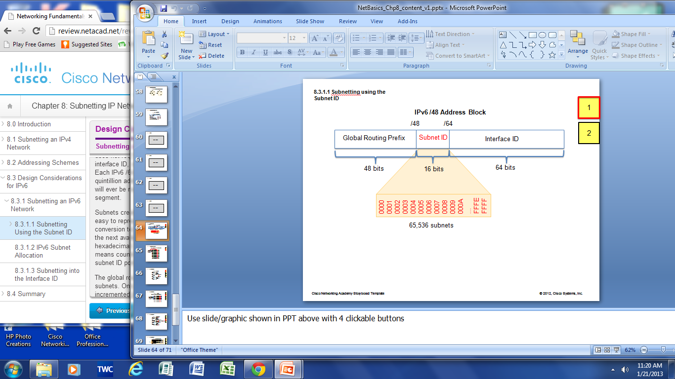
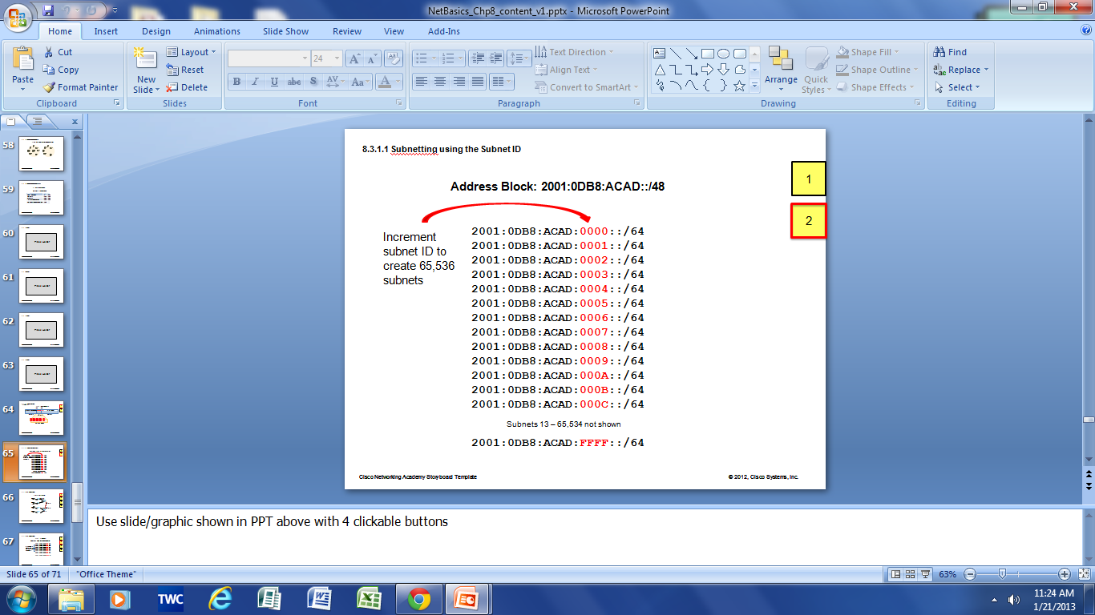
Subnetting an IPv6 Network Subnetting Using the Subnet ID
An IPv6 Network Space is subnetted to support hierarchical, logical design of the network
Notes:
9.3 Design Considerations for IPv6
9.3.1 Subnetting an IPv6 Network
9.3.1.1 Subnetting Using the Subnet ID

Slide 23
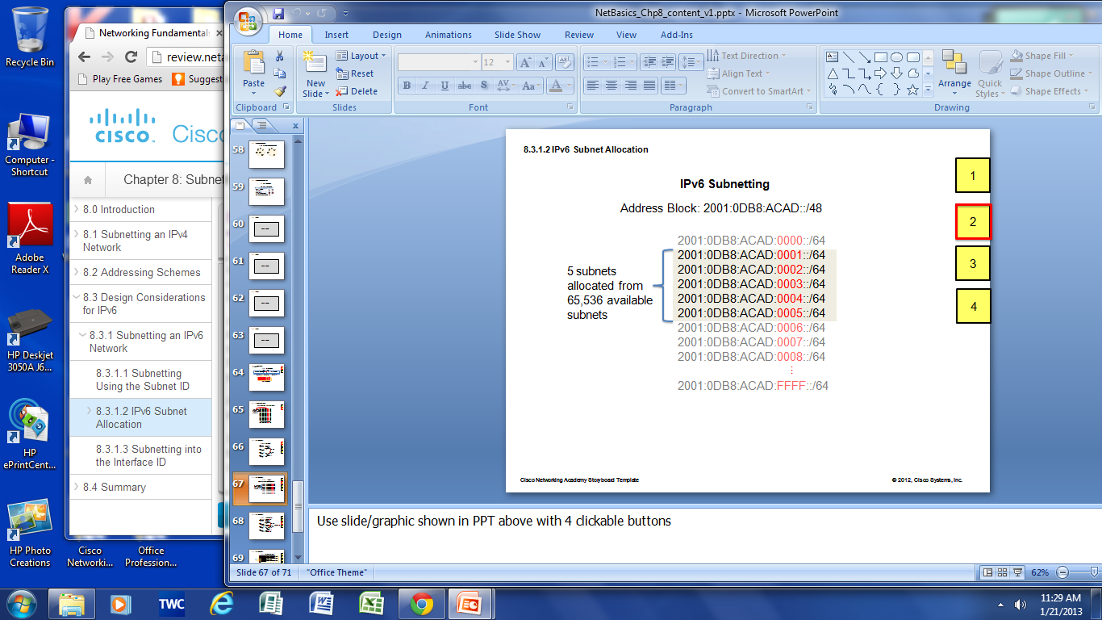
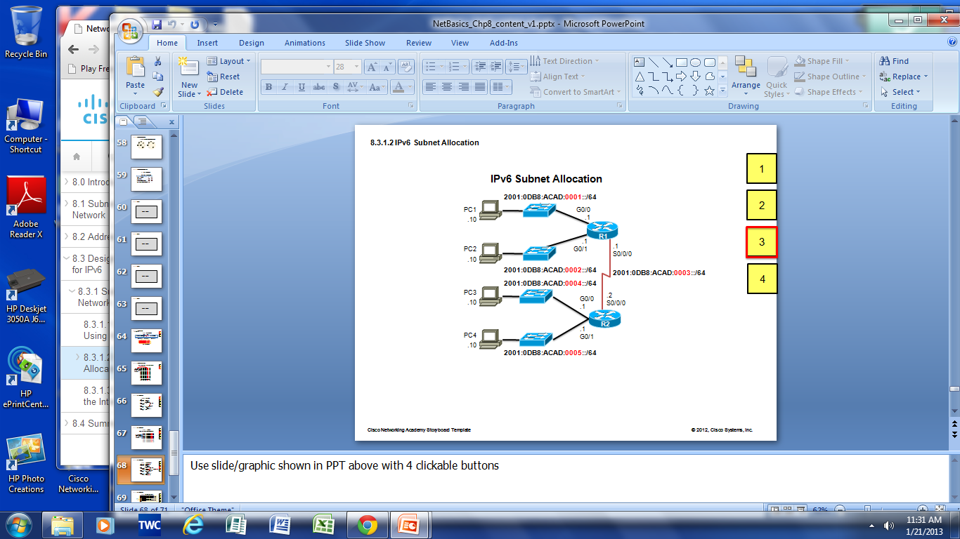
Subnetting an IPv6 Network IPV6 Subnet Allocation
Notes:
9.3.1.2 IPv6 Subnet Allocation

Slide 24
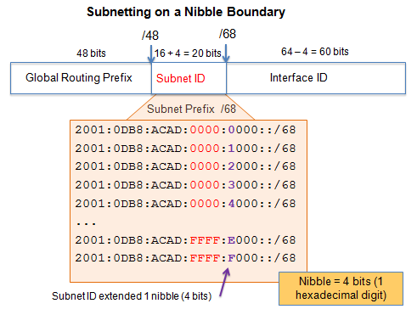
Subnetting an IPv6 Network Subnetting into the Interface ID
IPv6 bits can be borrowed from the interface ID to create additional IPv6 subnets
Notes:
9.3.1.3 Subnetting into the Interface ID

Slide 25
Chapter 9: Summary
Process of segmenting a network, by dividing it into to multiple smaller network spaces, is called subnetting.
Subnetting a subnet, or using Variable Length Subnet Mask (VLSM) was designed to avoid wasting addresses.
IPv6 address space is a huge address space so it is subnetted to support the hierarchical, logical design of the network not to conserve addresses.
Size, location, use, and access requirements are all considerations in the address planning process.
IP networks need to be tested to verify connectivity and operational performance.
Notes:
Chapter 9 Summary

Slide 26


